Slide 1


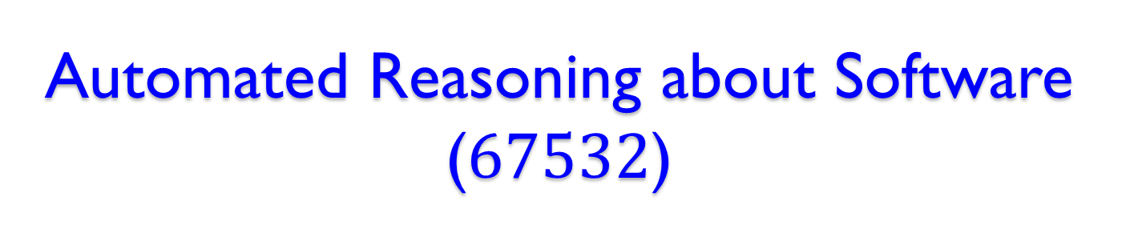
Automated Reasoning about Software ($67532$)
Guy Katz
Lecture $4$: SAT Solver Applications and Challenges November $5$^{th}, $2018$

Slide 2
Acknowledgements
Some of the material presented has been borrowed from slides by David Dill, Isil Dillig, Gera Weiss, Clark Barrett, Alex Aiken, Moshe Vardi, Mooly Sagiv and Ofer Strichman

Slide 3
Overview
Previously: architecture of modern solvers
DPLL ,CDCL
Today: some SAT solver applications
Product configuration
Hardware manufacturing
Bounded model checking
Some variations and challenges

Slide 4
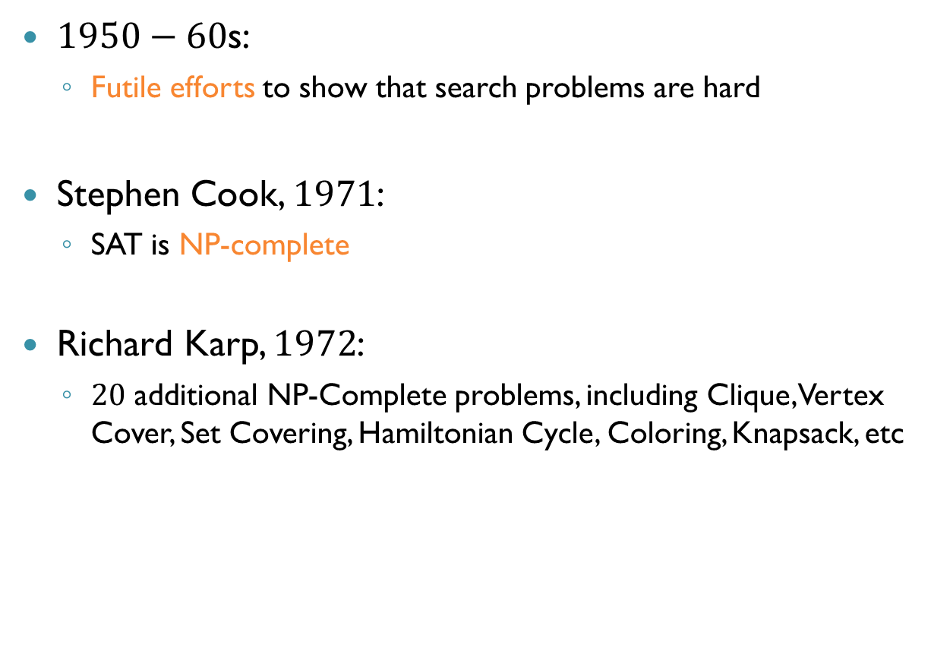
Some History
$1950−60$s:
Futile efforts to show that search problems are hard
Stephen Cook, $1971$:
SAT is NP-complete
Richard Karp, $1972$:
$20$ additional NP-Complete problems, including Clique, Vertex Cover, Set Covering, Hamiltonian Cycle, Coloring, Knapsack, etc

Slide 5
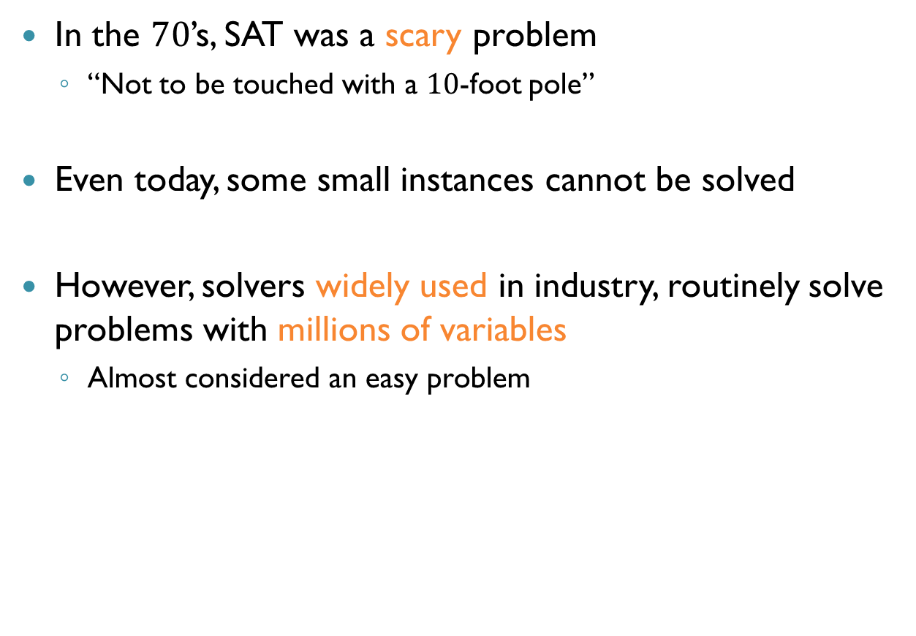
Some History (cnt’d)
In the $70$’s, SAT was a scary problem
“Not to be touched with a $10$-foot pole”
Even today, some small instances cannot be solved
However, solvers widely used in industry, routinely solve problems with millions of variables
Almost considered an easy problem

Slide 6
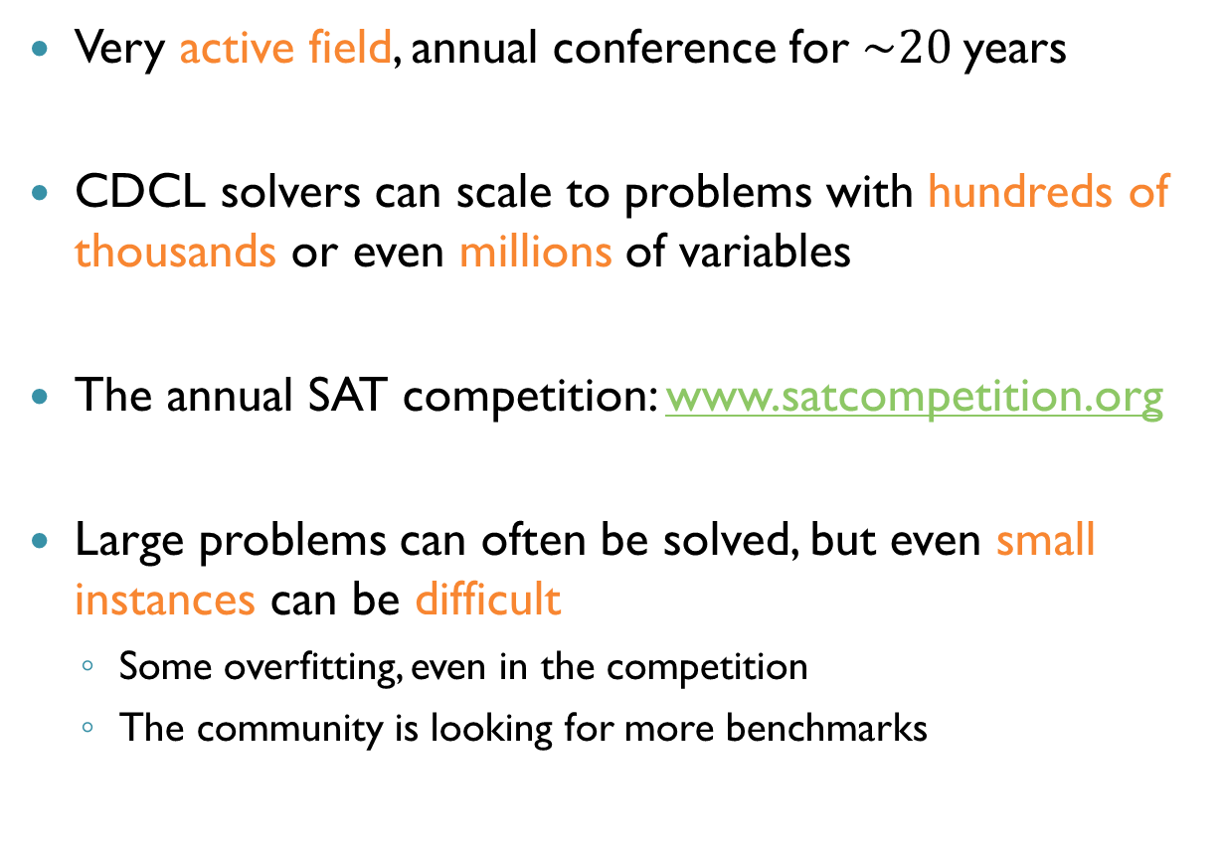
Today’s Landscape in SAT Solving
Very active field, annual conference for $\sim 20$years
CDCL solvers can scale to problems with hundreds of thousands or even millions of variables
The annual SAT competition: www.satcompetition.org
Large problems can often be solved, but even small instances can be difficult
Some overfitting, even in the competition
The community is looking for more benchmarks

Slide 7
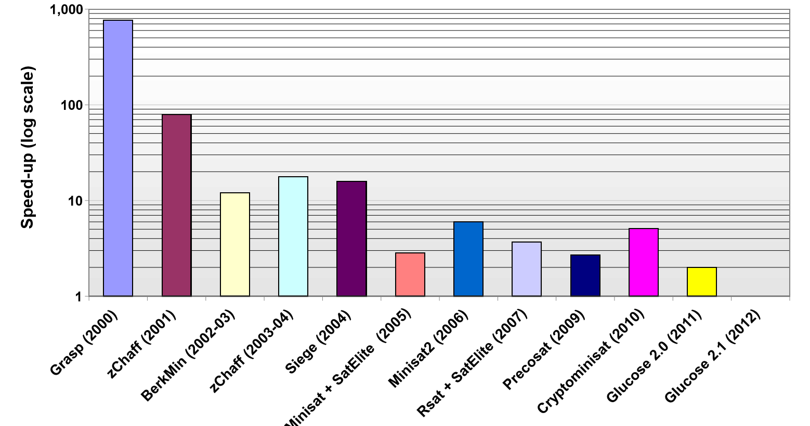
SAT Solver Speedups

Slide 8
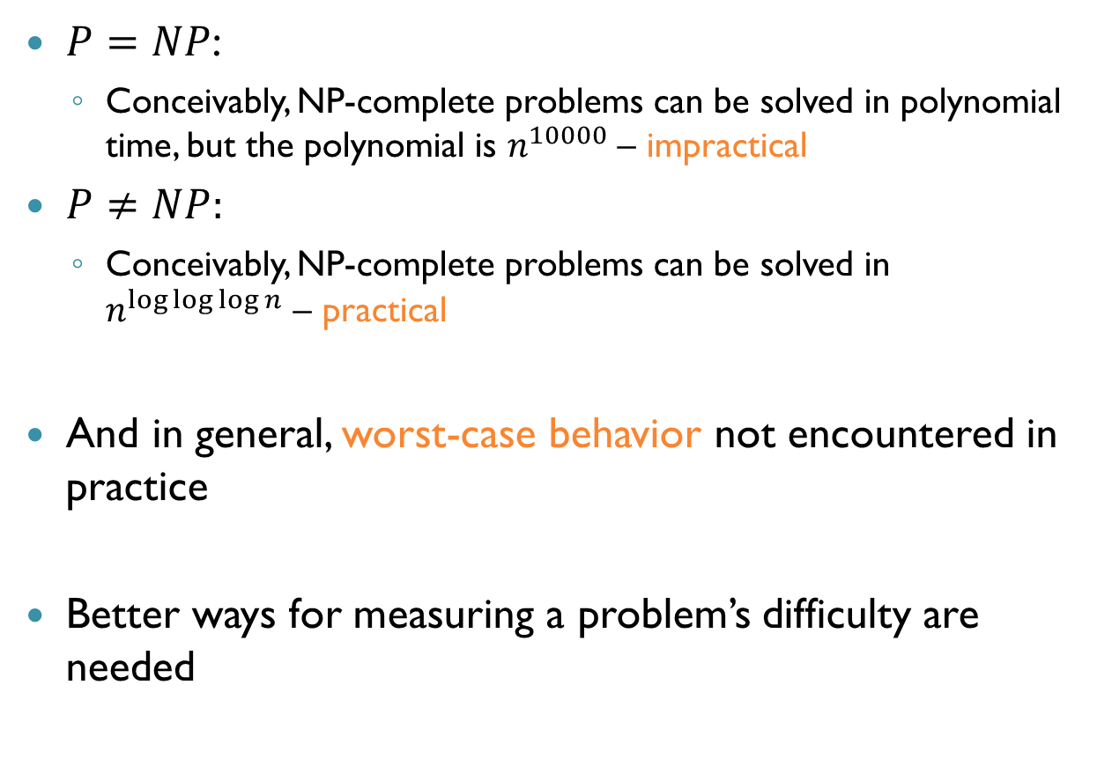
P and NP
$P=NP$:
Conceivably, NP-complete problems can be solved in polynomial time, but the polynomial is $n^{10000}$ – impractical
$P≠NP:$
Conceivably, NP-complete problems can be solved in $n^{\log{\log{\log{n}}}}$ – practical
And in general, worst-case behavior not encountered in practice
Better ways for measuring a problem’s difficulty are needed

Slide 9
Why Focus on SAT?
Many interesting problems can be reduced to SAT
Idea: write highly optimized SAT solver, and use it to solve any NP-complete problem
However, the encoding matters a lot
Often the case in many verification tools
Knowing something about CDCL is useful

Slide 10
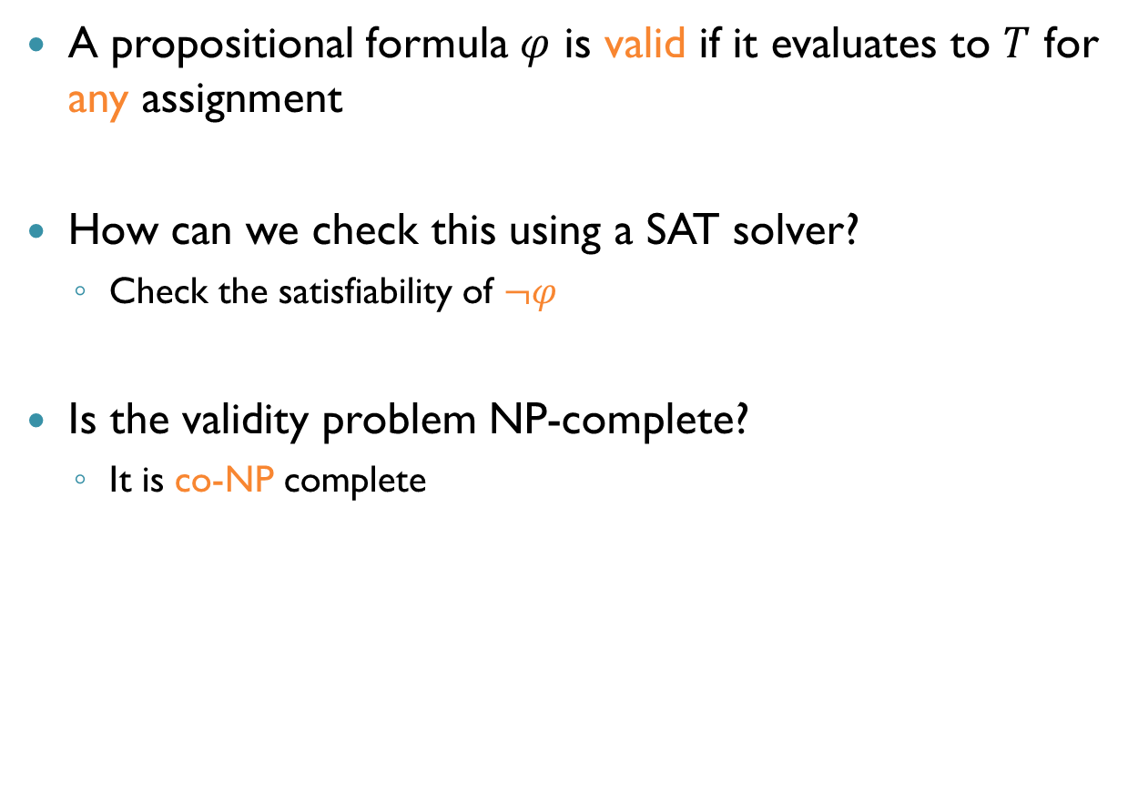
Validity
A propositional formula $φ$ is valid if it evaluates to $T$ for any assignment
How can we check this using a SAT solver?
Check the satisfiability of $¬φ$
Is the validity problem NP-complete?
It is co-NP complete

Slide 11
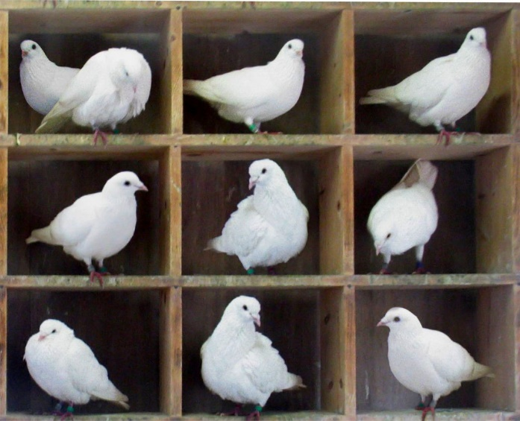
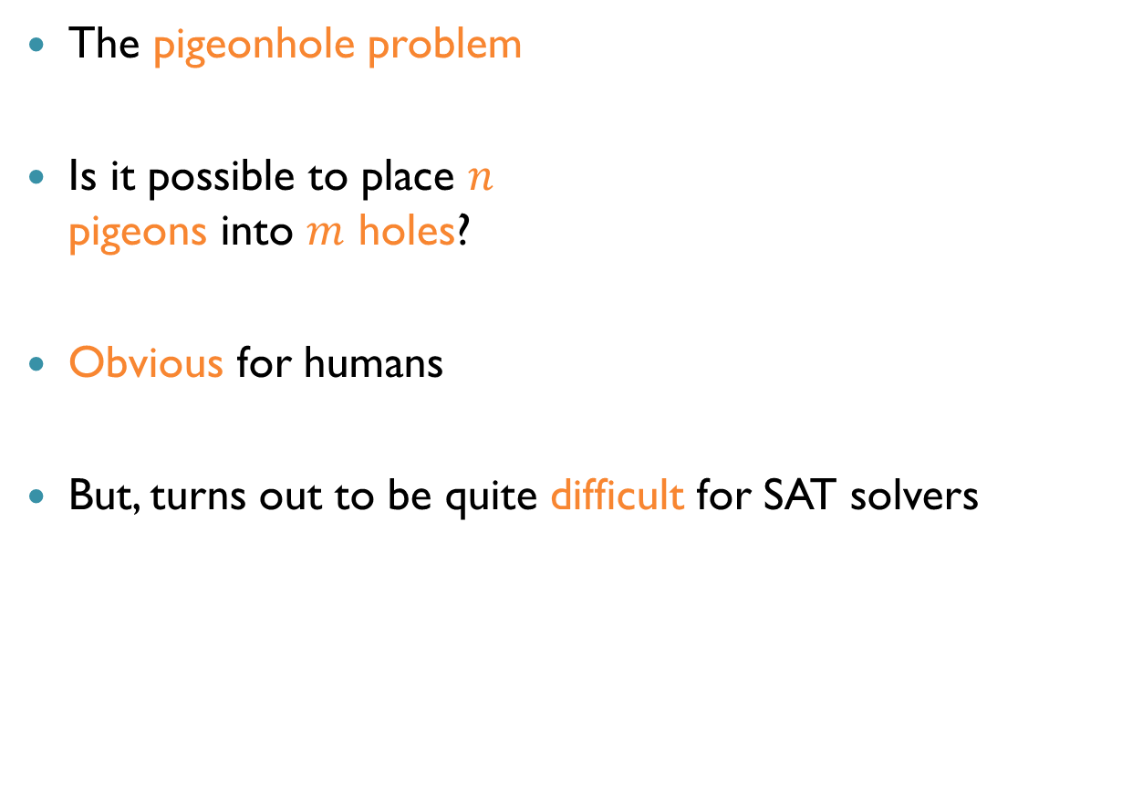
A Small Yet Difficult Problem
The pigeonhole problem
Is it possible to place $n$ pigeons into $m$ holes?
Obvious for humans
But, turns out to be quite difficult for SAT solvers

Slide 12
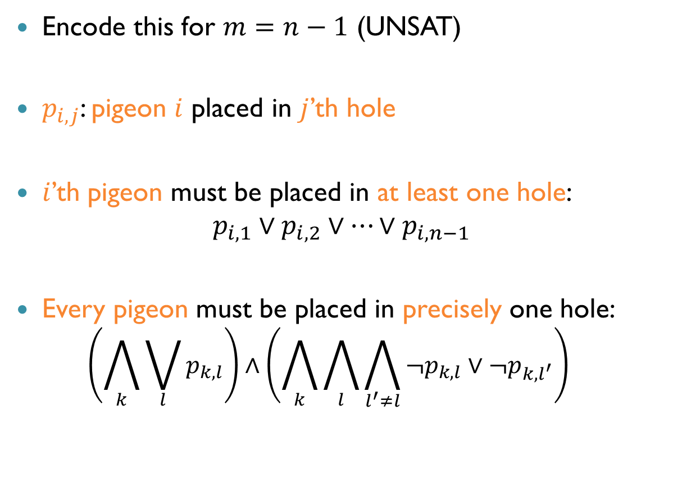
The Pigeonhole Problem
Encode this for $m=n−1$ (UNSAT)
$p_{i,j}$: pigeon $i$ placed in $j$’th hole
$i$’th pigeon must be placed in at least one hole: $p_{i,1}∨p_{i,2}∨…∨p_{i, n−1}$
Every pigeon must be placed in precisely one hole: $\left(\bigwedge_{k}{\bigvee_{l}{p_{k,l}}}\right)∧\left(\bigwedge_{k}{\bigwedge_{l}{\bigwedge_{l^{′}≠l}{{¬p}_{k,l}∨¬p_{k,l^{′}}}}}\right)$

Slide 13
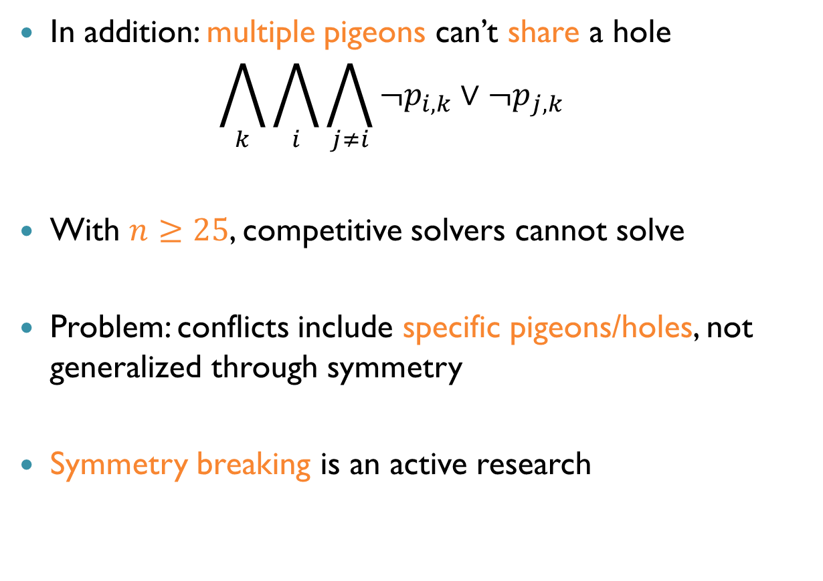
The Pigeonhole Problem (cnt’d)
In addition: multiple pigeons can’t share a hole $\bigwedge_{k}{\bigwedge_{i}{\bigwedge_{j≠i}{¬p_{i,k}∨¬p_{j,k}}}}$
With $n≥25$, competitive solvers cannot solve
Problem: conflicts include specific pigeons/holes, not generalized through symmetry
Symmetry breaking is an active research

Slide 14
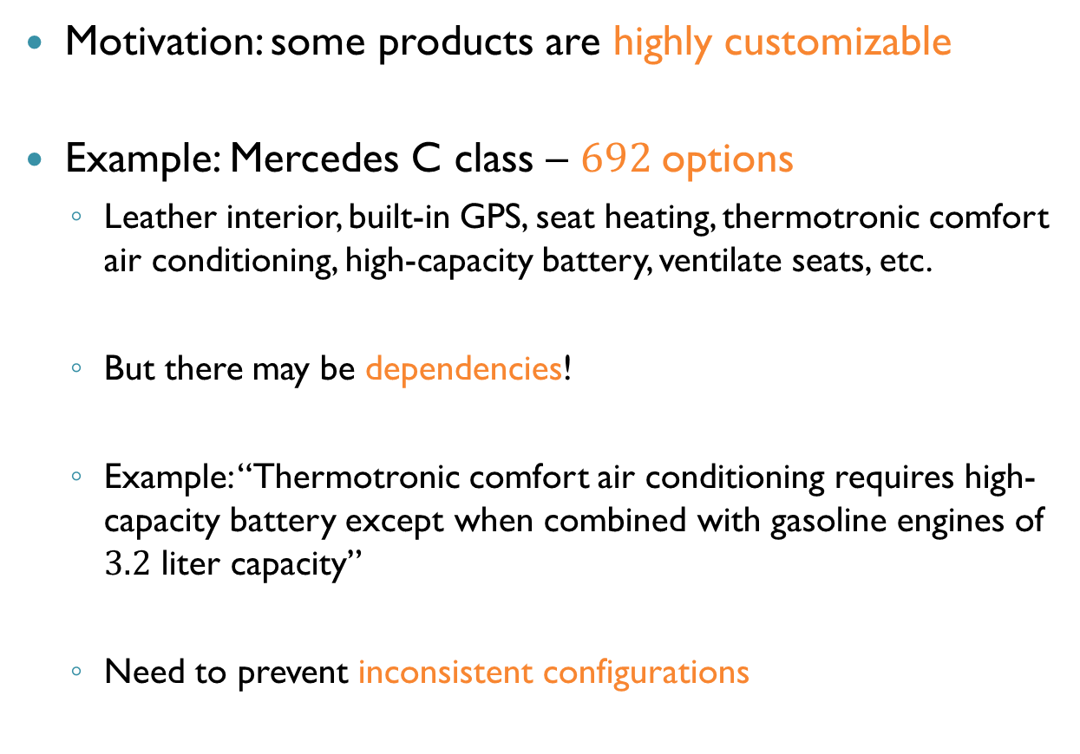
Application: Product Configuration
Motivation: some products are highly customizable
Example: Mercedes C class – $692$options
Leather interior, built-in GPS, seat heating, thermotronic comfort air conditioning, high-capacity battery, ventilate seats, etc.
But there may be dependencies!
Example: “Thermotronic comfort air conditioning requires high-capacity battery except when combined with gasoline engines of $3.2$ liter capacity”
Need to prevent inconsistent configurations

Slide 15
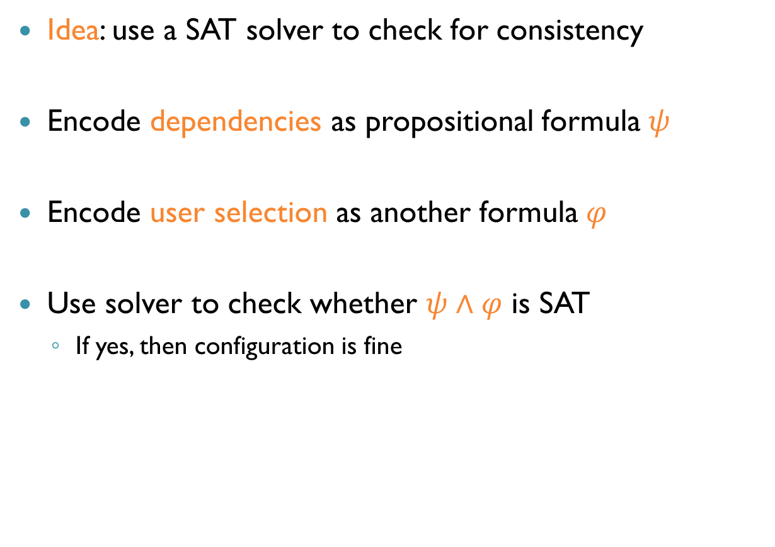
Configurations using SAT
Idea: use a SAT solver to check for consistency
Encode dependencies as propositional formula $ψ$
Encode user selection as another formula $φ$
Use solver to check whether $ψ∧φ$ is SAT
If yes, then configuration is fine

Slide 16
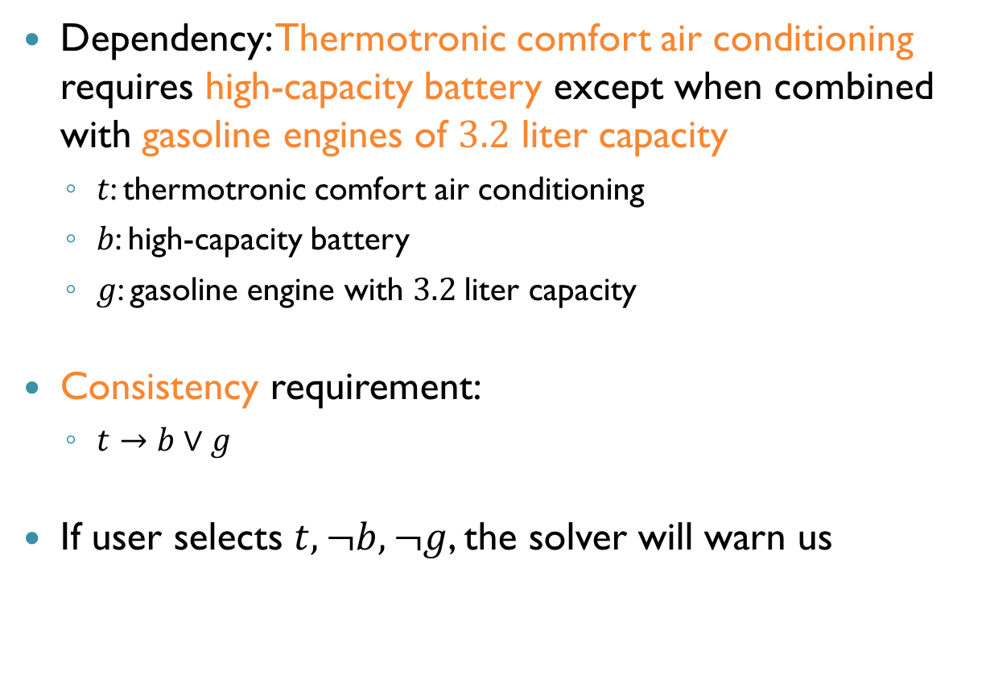
Example: Configurations using SAT
Dependency: Thermotronic comfort air conditioning requires high-capacity battery except when combined with gasoline engines of $3.2$ liter capacity
$t$: thermotronic comfort air conditioning
$b$: high-capacity battery
$g$: gasoline engine with $3.2$liter capacity
Consistency requirement:
$t→b∨g$
If user selects $t,¬b,¬g$, the solver will warn us

Slide 17
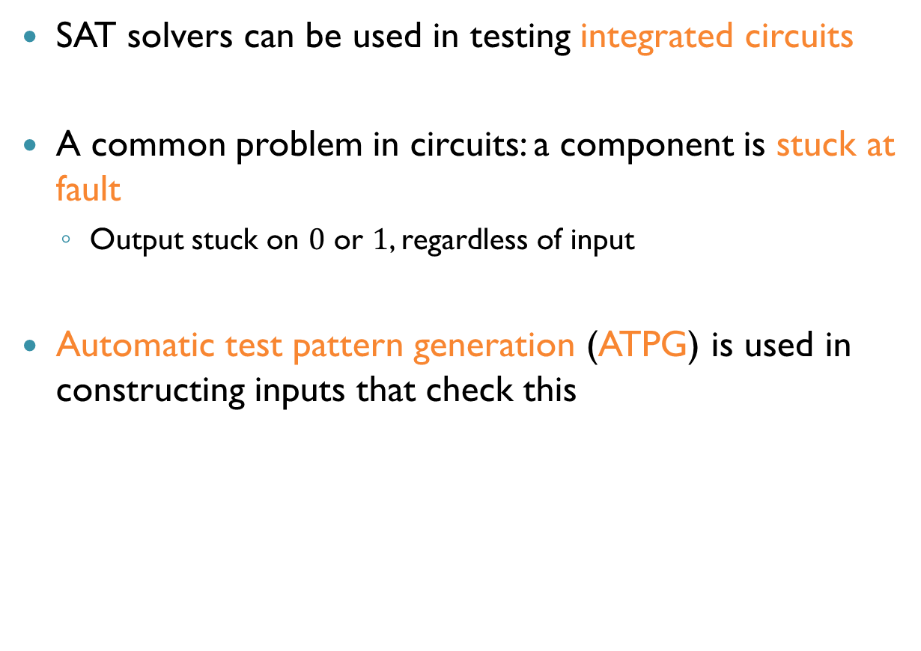
Application: ATPG
SAT solvers can be used in testing integrated circuits
A common problem in circuits: a component is stuck at fault
Output stuck on $0$ or $1$, regardless of input
Automatic test pattern generation (ATPG) is used in constructing inputs that check this

Slide 18
ATPG Using SAT
Encode the circuit as two propositional formulas
First: “the good circuit” – the circuit without any faulty components
Second: “the faulty circuit” – represents the circuit with a particular component stuck at fault
Use solvers to find inputs that produce different outputs on the two circuits

Slide 19
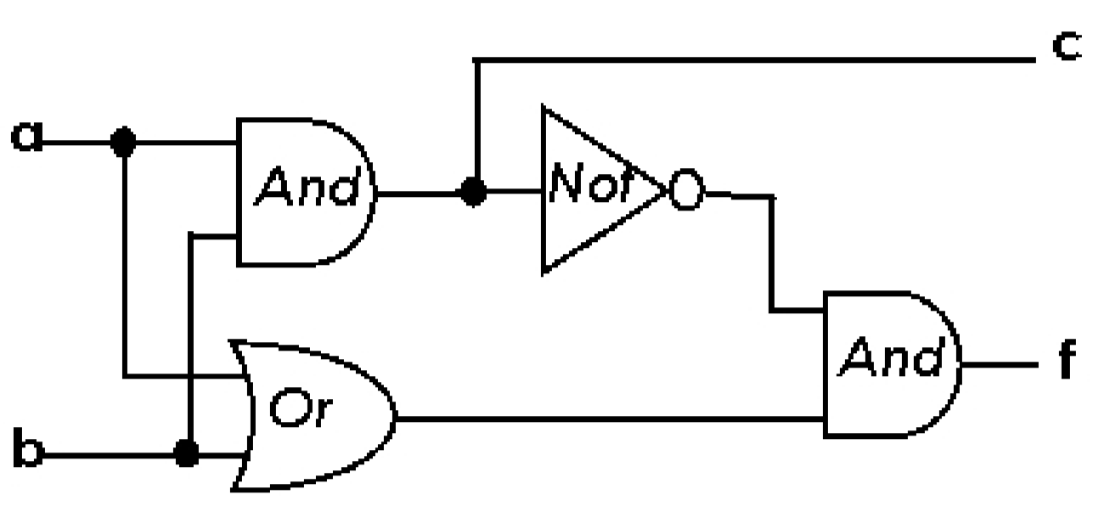
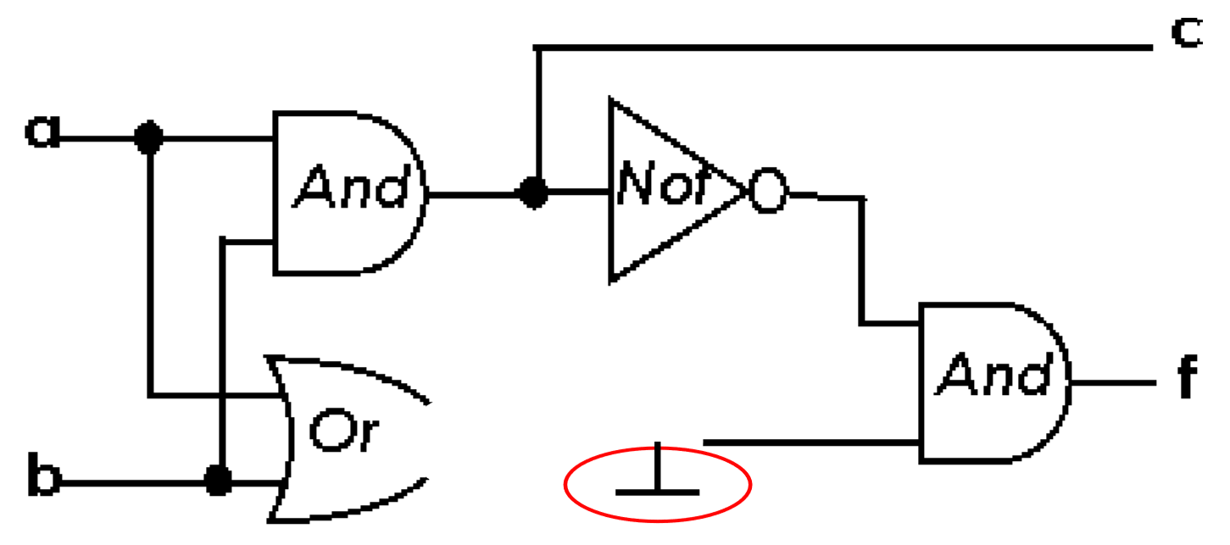

Example: ATPG Using SAT
Good circuit:
Faulty circuit:
The “or” component is stuck at $0$

Slide 20
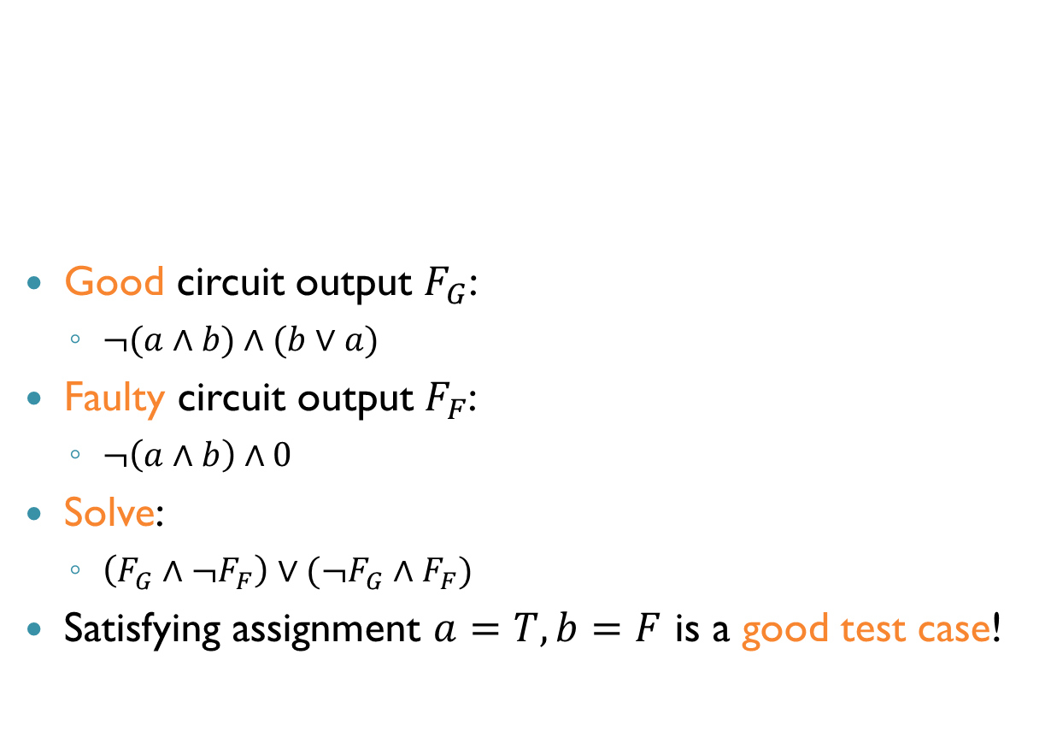
Example: ATPG Using SAT (cnt’d)
Good circuit output $F_{G}$:
$¬(a∧b)∧(b∨a)$
Faulty circuit output $F_{F}$:
$¬\left(a∧b\right)∧0$
Solve:
$\left(F_{G}∧¬F_{F}\right)∨(¬F_{G}∧F_{F})$
Satisfying assignment $a=T,b=F$ is a good test case!

Slide 21
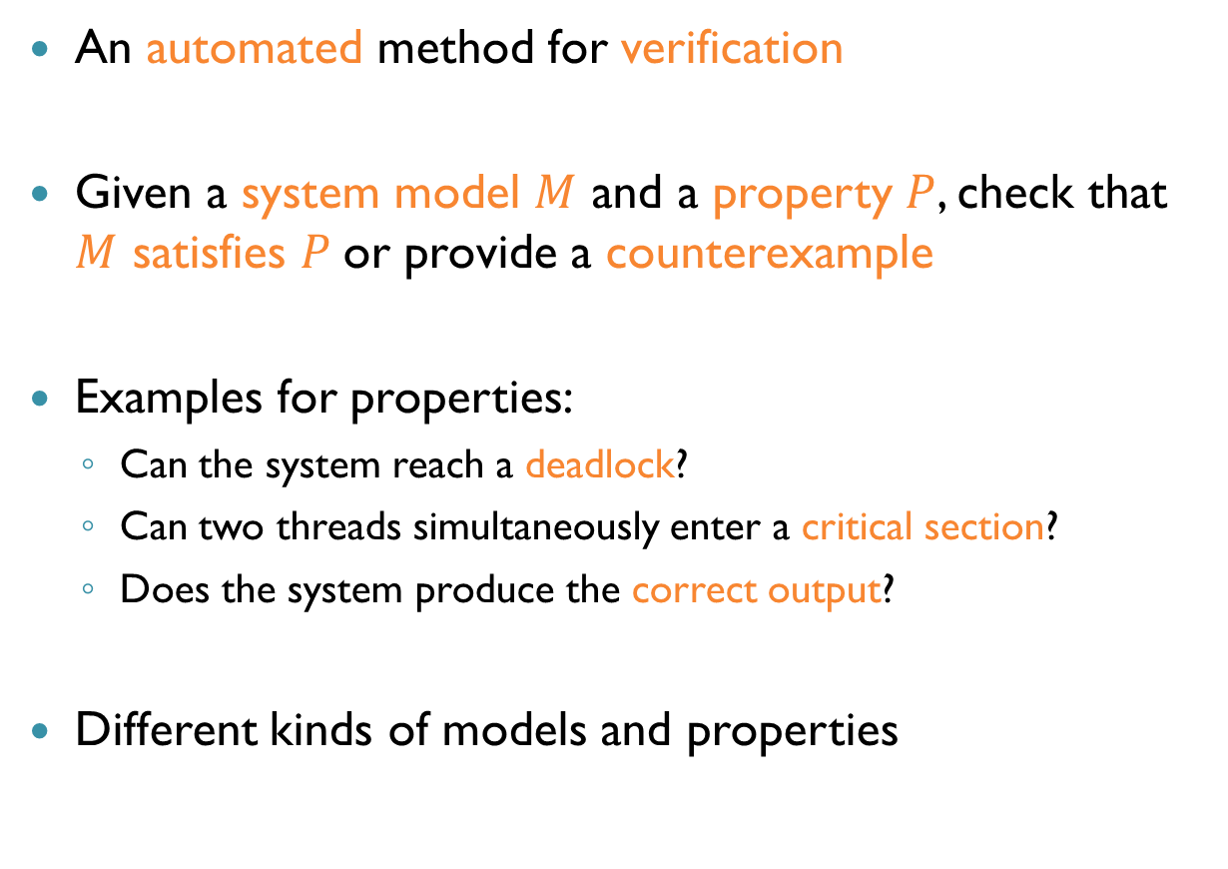
Model Checking
An automated method for verification
Given a system model $M$ and a property $P$, check that $M$ satisfies $P$ or provide a counterexample
Examples for properties:
Can the system reach a deadlock?
Can two threads simultaneously enter a critical section?
Does the system produce the correct output?
Different kinds of models and properties

Slide 22
Model Checking (cnt’d)
All possible executions
Executions satisfying property
Program executions
Counterexample

Slide 23
Model Checking: Advantages
Widely applicable (software, hardware, protocols, etc.)
Allows partial verification – only the most relevant properties
Fully automated, and provides mathematical guarantees
Complete coverage, not just common scenarios
Provides a counterexample when property fails

Slide 24
Model Checking: Disadvantages
Usually checks the control flow of reactive systems, not so much the accuracy of computations
Model quality plays a crucial role
Key problem: state explosion

Slide 25
Model Checking: Safety Properties
Simple case:
Model is a transition system
Safety property: bad things do not happen
Some states in the transition system marked as bad
Verification: are any bad states reachable from the initial state?
Linear in the size of the transition system
State explosion: models can be huge (exponential in program size)
Can even be infinite

Slide 26
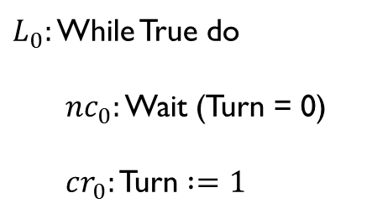


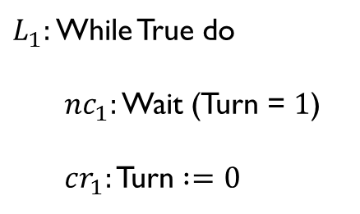
Example: Mutual Exclusion
Goal: check that never $cr_{0}∧cr_{1}$
$L_{0}:$ While True do
$nc_{0}:$ Wait (Turn = 0)
$cr_{0}:$ Turn $:=$ $1$
$L_{1}:$ While True do
$nc_{1}:$ Wait (Turn = $1$)
$cr_{1}:$ Turn $:=$ $0$
$$||$$

Slide 27

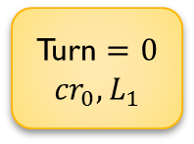
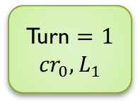
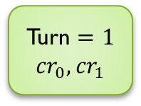
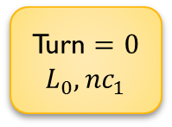
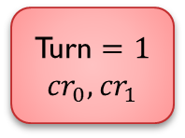
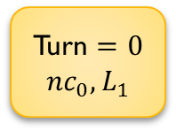
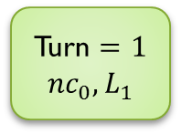
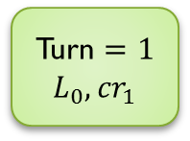
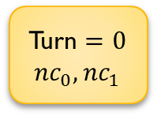
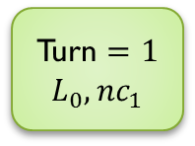
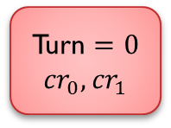
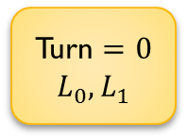
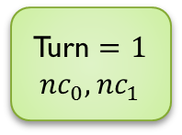
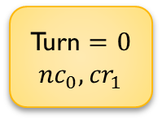
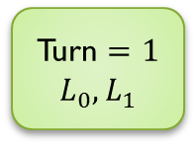
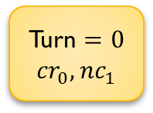
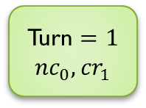
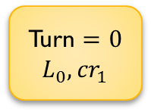
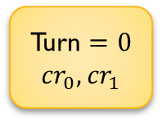
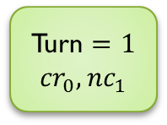
Example: Mutual Exclusion (cnt’d)
Turn $=$ $0$ $$L_{0},L_{1}$$
Turn $=$ $1$ $$L_{0},L_{1}$$
Model this program as a transition system
Turn $=$ $0$ $$L_{0},{nc}_{1}$$
Turn $=$ $1$ $${nc}_{0},L_{1}$$
Turn $=$ $0$ $${nc}_{0},L_{1}$$
Turn $=$ $1$ $$L_{0},{nc}_{1}$$
Turn $=$ $0$ $${nc}_{0},{nc}_{1}$$
Turn $=$ $1$ $${nc}_{0},{nc}_{1}$$
Turn $=$ $0$ $${cr}_{0},L_{1}$$
Turn $=$ $1$ $$L_{0},{cr}_{1}$$
Turn $=$ $0$ $$L_{0},{cr}_{1}$$
Turn $=$ $1$ $${cr}_{0},L_{1}$$
Turn $=$ $0$ $${cr}_{0},{nc}_{1}$$
Turn $=$ $1$ $${nc}_{0},{cr}_{1}$$
Turn $=$ $0$ $${nc}_{0},{cr}_{1}$$
Turn $=$ $1$ $${cr}_{0},{nc}_{1}$$
Turn $=$ $0$ $${cr}_{0},{cr}_{1}$$
Turn $=$ $0$ $${cr}_{0},{cr}_{1}$$
Turn $=$ $1$ $${cr}_{0},{cr}_{1}$$
Turn $=$ $1$ $${cr}_{0},{cr}_{1}$$

Slide 28
Scaling-Up Model Checking
Symbolic model checking
Represent many system states as one symbolic state in the transition graph
Often means the use of Binary Decision Diagrams (BDDs)
Compositional verification
Verify components separately, deduce global correctness
Reductions, such as Partial Order Reduction
Bounded model checking

Slide 29
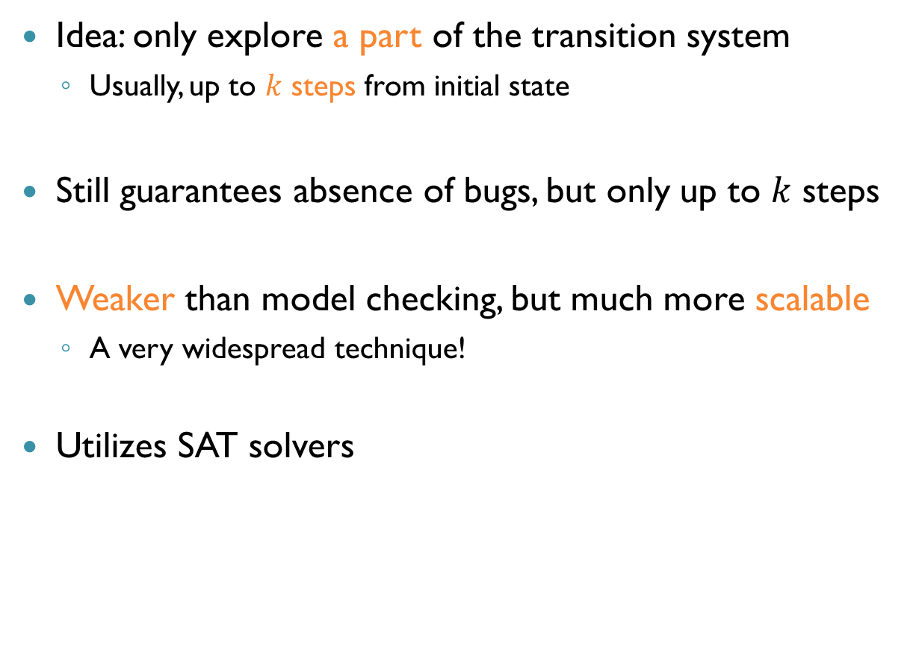
Bounded Model Checking
Idea: only explore a part of the transition system
Usually, up to $k$ steps from initial state
Still guarantees absence of bugs, but only up to $k$ steps
Weaker than model checking, but much more scalable
A very widespread technique!
Utilizes SAT solvers

Slide 30
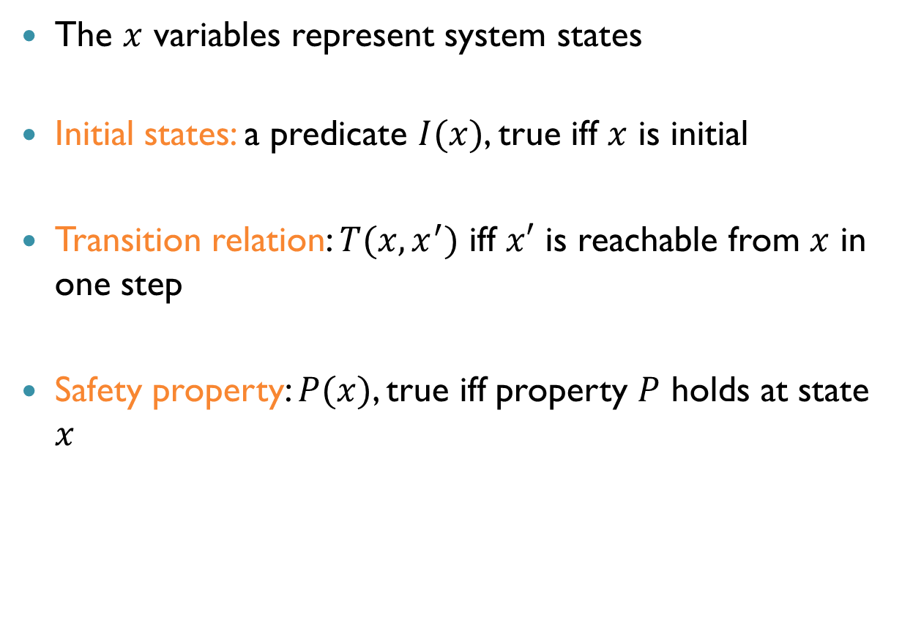
Bounded Model Checking (cnt’d)
The $x$ variables represent system states
Initial states: a predicate $I(x)$, true iff $x$ is initial
Transition relation: $T(x,x^{′})$ iff $x′$ is reachable from $x$ in one step
Safety property: $P(x)$, true iff property $P$ holds at state $x$

Slide 31
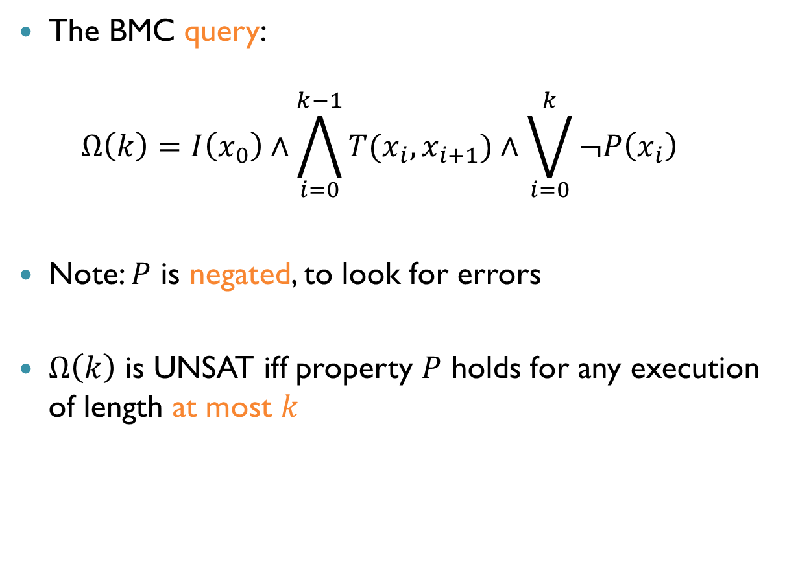
Bounded Model Checking (cnt’d)
The BMC query: $Ω\left(k\right)=I\left(x_{0}\right)∧\bigwedge_{i=0}^{k−1}{T(x_{i}, x_{i+1}})∧\bigvee_{i=0}^{k}{¬P\left(x_{i}\right)}$
Note: $P$ is negated, to look for errors
$Ω\left(k\right)$ is UNSAT iff property $P$ holds for any execution of length at most $k$

Slide 32

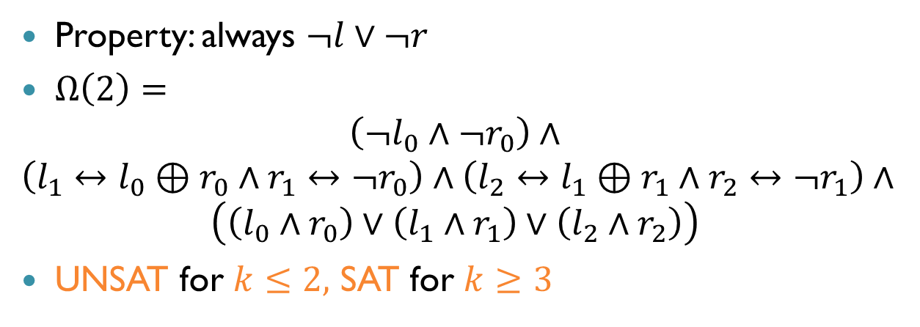

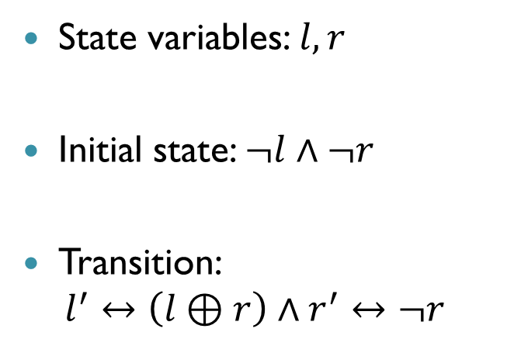


Example: Two Bit Counter
State variables: $l, r$
Initial state: $¬l∧¬r$
Transition: $l^{′}↔\left(l⊕r\right)∧r^{′}↔¬r$
$$00$$
$$11$$
$$01$$
$$10$$
Property: always $¬l∨¬r$
$Ω\left(2\right)=$ $\left(¬l_{0}∧¬r_{0}\right)∧$
$$\left(l_{1}↔l_{0}⊕r_{0}∧r_{1}↔¬r_{0}\right)∧\left(l_{2}↔l_{1}⊕r_{1}∧r_{2}↔¬r_{1}\right)∧$$
$$\left(\left(l_{0}∧r_{0}\right)∨\left(l_{1}∧r_{1}\right)∨\left(l_{2}∧r_{2}\right)\right)$$
UNSAT for $k≤2$, SAT for $k≥3$

Slide 33
Safety and Liveness
Safety: bad things never happen
Check whether there are reachable bad states
Liveness: good things eventually happen
Check whether there are reachable cycles without good states

Slide 34
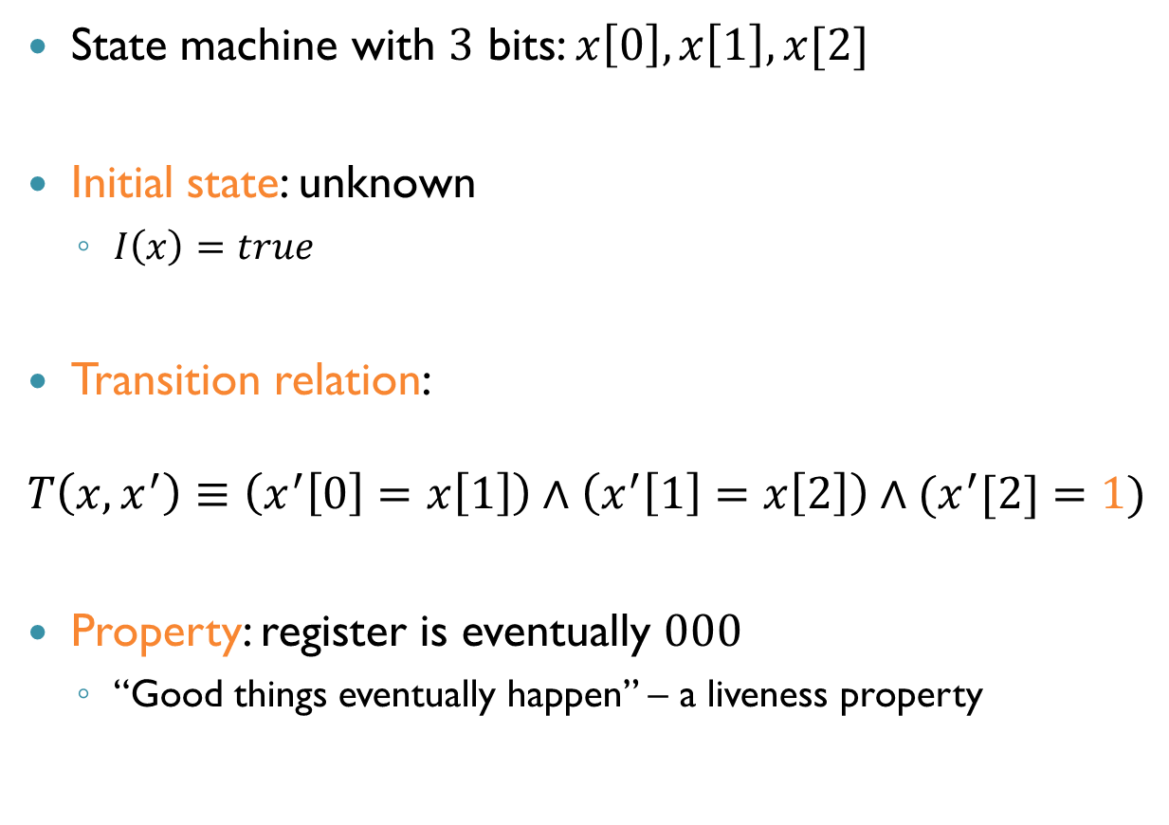
Example: Shift Left
State machine with $3$ bits: $x\left[0\right], x\left[1\right], x[2]$
Initial state: unknown
$I\left(x\right)=true$
Transition relation:
$$T\left(x,x^{′}\right)≡\left(x^{′}\left[0\right]=x\left[1\right]\right)∧\left(x^{′}\left[1\right]=x\left[2\right]\right)∧(x^{′}[2]=1)$$
Property: register is eventually $000$
“Good things eventually happen” – a liveness property

Slide 35
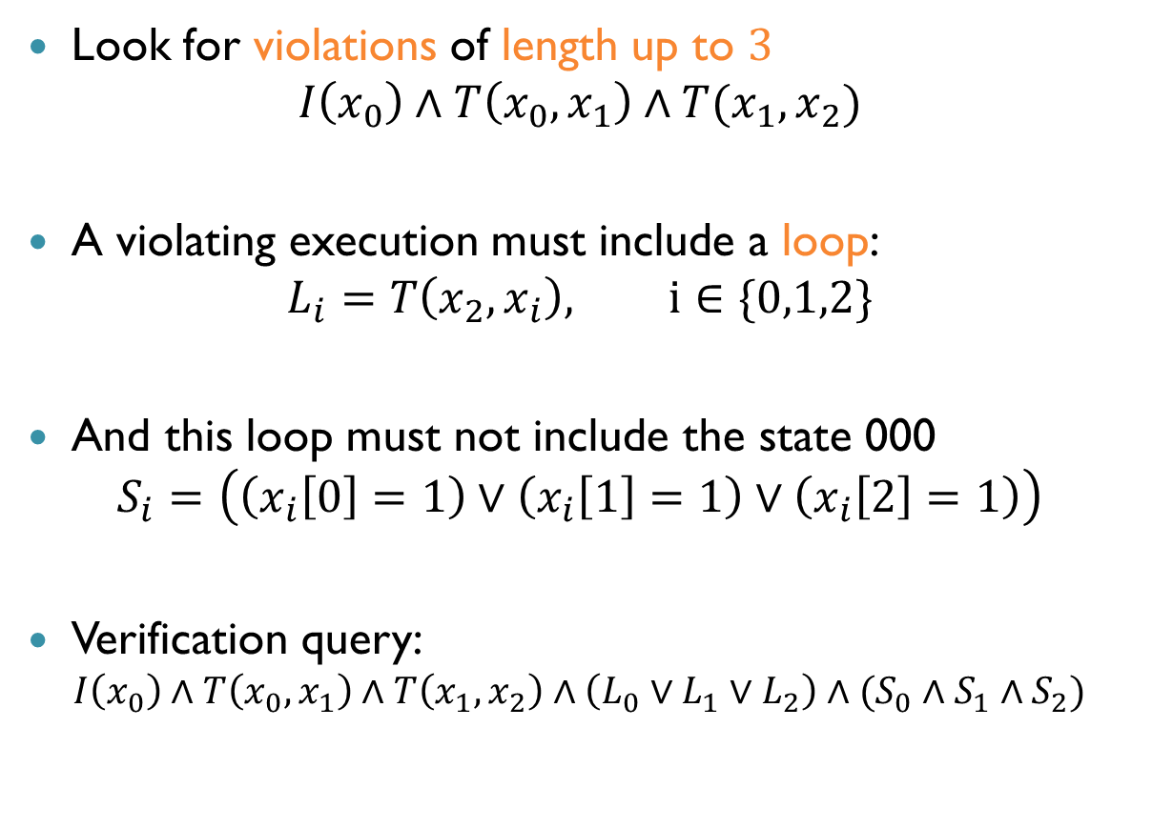
Example: Shift Left (cnt’d)
Look for violations of length up to $3$
$$I\left(x_{0}\right)∧T\left(x_{0},x_{1}\right)∧T(x_{1},x_{2})$$
A violating execution must include a loop:
$$L_{i}=T\left(x_{2},x_{i}\right), i∈\{0,1,2\}$$
And this loop must not include the state 000
$$S_{i}=\left(\left(x_{i}\left[0\right]=1\right)∨\left(x_{i}\left[1\right]=1\right)∨\left(x_{i}\left[2\right]=1\right)\right)$$
Verification query:
$$I\left(x_{0}\right)∧T\left(x_{0},x_{1}\right)∧T\left(x_{1},x_{2}\right)∧\left({L_{0}∨L}_{1}∨L_{2}\right)∧(S_{0}∧S_{1}∧S_{2})$$

Slide 36


Example: Shift Left (cnt’d)
SAT solver returns counter example: all variables are $1$

Slide 37









BMC With Increasing Lengths
If UNSAT, can iteratively increase $k$
$$k=0$$
BMC($M,P,k)$
$$M⊭_{k}P$$
$$M⊭P$$
$k$++
$$M⊨_{k}P$$
Yes
$$k≥ ?$$
$$M⊨P$$
No

Slide 38


How Large Should k Be?
For finite transition systems, there is always a $k$ such that
For particular classes of properties, lower thresholds exist
Can settle for approximations
$$M⊨_{k}P⇒M⊨P$$

Slide 39


$k$-Induction
BMC is aimed at finding violating runs
Refuting properties
$k$-Induction is a related approach for proving properties
Suppose we wish to prove the property: always $φ$
A safety property
If we can prove that:
$φ$ holds initially
If state $s$ satisfies $φ$, the successors of $s$ satisfy $φ$
Then by induction, $φ$ always holds

Slide 40

$k$-Induction (cnt’d)
Unfortunately, this approach rarely works
Even when the property does hold
Why?
Unreachable states!

Slide 41
$k$-Induction (cnt’d)
Turn $=$ $0$ $$L_{0},L_{1}$$
Turn $=$ $1$ $$L_{0},L_{1}$$
Turn $=$ $0$ $$L_{0},{nc}_{1}$$
Turn $=$ $1$ $${nc}_{0},L_{1}$$
Turn $=$ $0$ $${nc}_{0},L_{1}$$
Turn $=$ $1$ $$L_{0},{nc}_{1}$$
Turn $=$ $0$ $${nc}_{0},{nc}_{1}$$
Turn $=$ $1$ $${nc}_{0},{nc}_{1}$$
Turn $=$ $0$ $${cr}_{0},L_{1}$$
Turn $=$ $1$ $$L_{0},{cr}_{1}$$
Turn $=$ $0$ $$L_{0},{cr}_{1}$$
Turn $=$ $1$ $${cr}_{0},L_{1}$$
Turn $=$ $0$ $${cr}_{0},{nc}_{1}$$
Turn $=$ $1$ $${nc}_{0},{cr}_{1}$$
Turn $=$ $0$ $${nc}_{0},{cr}_{1}$$
Turn $=$ $1$ $${cr}_{0},{nc}_{1}$$
Turn $=$ $0$ $${cr}_{0},{cr}_{1}$$
Turn $=$ $0$ $${cr}_{0},{cr}_{1}$$
Turn $=$ $1$ $${cr}_{0},{cr}_{1}$$
Turn $=$ $1$ $${cr}_{0},{cr}_{1}$$

Slide 42

A Better Method
Check that states reachable from the initial state in $k$ steps satisfy $φ$
Using BMC
Check that if $φ$ holds on all $k$-long paths, then it also holds for state number $k+1$
Doesn’t have to start from the initial state
Can also be encoded into SAT
Together, this proves the desired property

Slide 43
$k$-Induction (cnt’d)
Turn $=$ $0$ $$L_{0},L_{1}$$
Turn $=$ $1$ $$L_{0},L_{1}$$
Turn $=$ $0$ $$L_{0},{nc}_{1}$$
Turn $=$ $1$ $${nc}_{0},L_{1}$$
Turn $=$ $0$ $${nc}_{0},L_{1}$$
Turn $=$ $1$ $$L_{0},{nc}_{1}$$
Turn $=$ $0$ $${nc}_{0},{nc}_{1}$$
Turn $=$ $1$ $${nc}_{0},{nc}_{1}$$
Turn $=$ $0$ $${cr}_{0},L_{1}$$
Turn $=$ $1$ $$L_{0},{cr}_{1}$$
Turn $=$ $0$ $$L_{0},{cr}_{1}$$
Turn $=$ $1$ $${cr}_{0},L_{1}$$
Turn $=$ $0$ $${cr}_{0},{nc}_{1}$$
Turn $=$ $1$ $${nc}_{0},{cr}_{1}$$
Turn $=$ $0$ $${nc}_{0},{cr}_{1}$$
Turn $=$ $1$ $${cr}_{0},{nc}_{1}$$
Turn $=$ $0$ $${cr}_{0},{cr}_{1}$$
Turn $=$ $0$ $${cr}_{0},{cr}_{1}$$
Turn $=$ $1$ $${cr}_{0},{cr}_{1}$$
Turn $=$ $1$ $${cr}_{0},{cr}_{1}$$

Slide 44




Further Improvements?
Consider the following situation:
For which $k$ can we prove correctness using $k$ induction?
We can change the encoding to consider only loop-free paths
$$φ$$
$$φ$$
$$φ$$
$$¬φ$$

Slide 45

Other Variations of SAT
The basic satisfiability problem: given a propositional formula $φ$, is $φ$ satisfiable?
Common variations:
Maximum Satisfiability (MaxSAT)
Partial MaxSAT
Weighted MaxSAT
UNSAT Cores

Slide 46

Maximum Satisfiability (MaxSAT)
MaxSAT: Given a formula $φ$ in CNF, find an assignment that maximizes the number of satisfied clauses in $φ$
Observe: if $φ$ is SAT, the answer is just a satisfying assignment (all clauses will be satisfied)
If $φ$ is UNSAT, we want to find a maximal subset of $φ^{′}s$ clauses whose conjunction is SAT
Example: $\left(a∨b\right)∧¬a∧¬b$
Maximal number of satisfied clauses: $2$

Slide 47

Partial MaxSAT
Similar to MaxSAT, but we distinguish between clauses:
Hard clauses: must be satisfied
Soft clauses: should, but don’t have to be, satisfied
Partial MaxSAT: given a CNF formula $φ$, where each clause is marked soft or hard, find an assignment that satisfies all the hard clauses and maximizes the number of satisfied soft clauses

Slide 48
Partial MaxSAT (cnt’d)
Regular SAT and MaxSAT are special cases of partial maxSAT
Regular SAT: all clauses are hard
MaxSAT: all clauses are soft
Partial MaxSAT is a generalization of SAT and MaxSAT

Slide 49
Partial Weighted MaxSAT
Yet another generalization
Soft clauses also have weights
A way to indicate importance
The goal: find an assignment that maximizes the weights of satisfied soft clauses
Partial MaxSAT is a private case, where all clauses have equal weights

Slide 50

Partial MaxSAT Application
Software package installation: you want to install software package $A$, but it has dependencies
Example: $A$ requires $B$, and is not compatible with package $C$
$B$ requires $D, E$ and is not compatible with $F$
Some packages (e.g., $C$) may already be installed
Question:
Can you install $A$?
Which software should you uninstall to install $A$?

Slide 51

Partial MaxSAT Application (cnt’d)
Can phrase this as a MaxSAT instance
Goal: install $A$: $A$
$A$ requires $B$: $A→B$
$A$ incompatible with $C$: $A→¬C$
$B$ requires $D,E$: $B→D∧E$
$B$ incompatible with $F$: $B→¬F$
$C$ already installed: $C$
SAT: can install $A$, and assignment will indicate dependencies that need to be installed
Partially SAT: violated soft clauses will indicate what to uninstall
Hard
Soft

Slide 52

Summary
Modern SAT solvers can handle hundreds of thousands of variables
Huge improvement in last $\sim 20$ years
Many mature tools available
Active research, annual conferences and competition
Some applications:
Product configurations
Automatic test pattern generation
Bounded model checking (safety and liveness properties)
Other variants: MaxSAT, (Weighted) Partial MaxSAT

